Slide 1

Министерство науки и высшего образования Российской Федерации
Федеральное государственное бюджетное образовательное учреждение высшего образования
«Московский государственный технический университет имени Н.Э. Баумана
(национальный исследовательский университет)»
(МГТУ им. Н.Э. Баумана)
Landscape generation
Student: Pronin Arseny
Group: IU7-62B

Slide 2
Goal and tasks
Goal – develop a program for generating and visualizing the landscape.
Tasks:
analyse representations of landscape data;
analyse landscape generation algorithms;
analyse hidden-surface removal algorithms;
choose the main tools for developing the program;
develop a program that implements the task;
compare the execution time of the ZBuffer algorithm without and using parallel threads;

Slide 3
Representation of landscape data
Heights map
Irregular grid
Segmented heights map

Slide 4
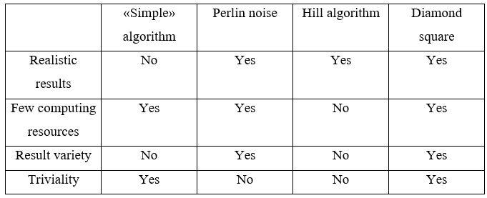
Choosing a generating algorithm

Slide 5
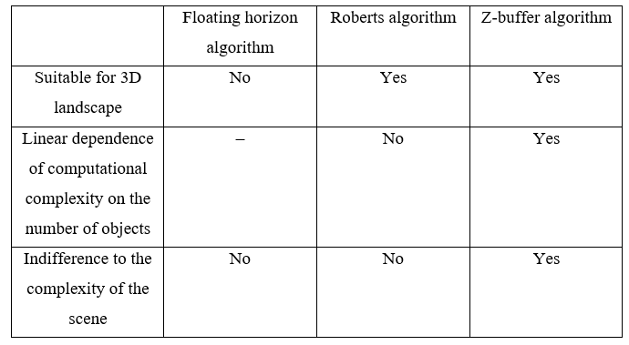
Choosing a hidden-surface removal algorithm

Slide 6
Main tools used for implementation and research
C++ programming language.
Cross-platform framework Qt.
Development environment Qt creator.
Version control system git.
Clock() library.

Slide 7
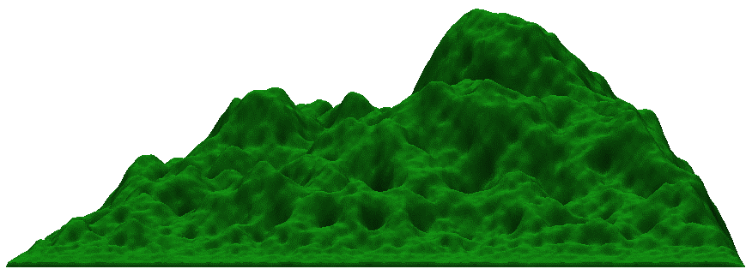
Program output examples

Slide 8
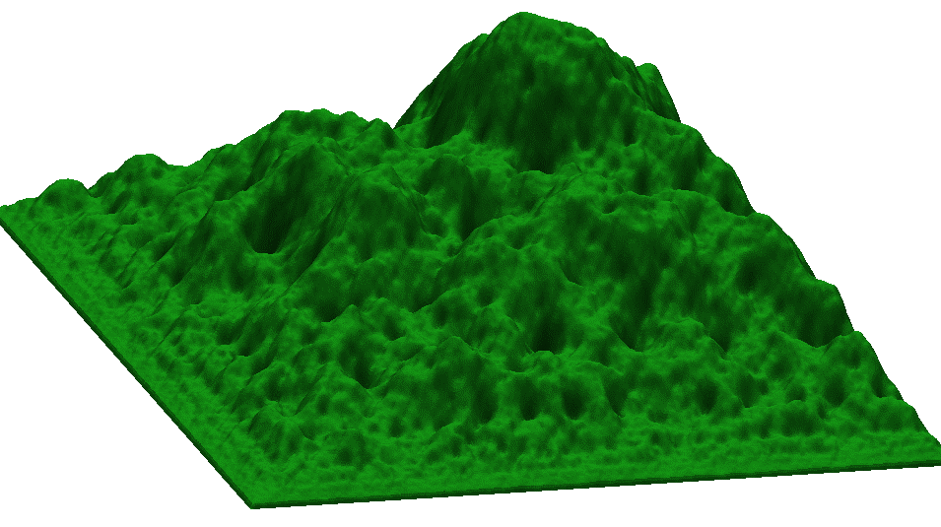
Program output examples

Slide 9
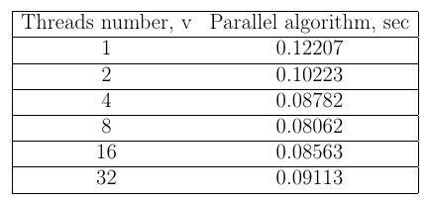
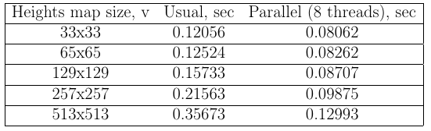
Execution time of the ZBuffer algorithm without and using parallel threads

Slide 10
Conclusion
As a result of the work done, the goal was achieved - a program for generating and visualizing a 3D landscape was developed.
Also, all the tasks were solved:
landscape data representations were analyzed;
landscape generation algorithms were analyzed;
hidden-surface removal algorithms were analyzed;
selected the main tools for developing the program;
a program has been developed that implements the task;
the execution time of the ZBuffer algorithm without and using parallel threads was compared;

